Slide 1
SYNCHRONOUS MACHINES AND FHP MOTORS
(5031)

Slide 2
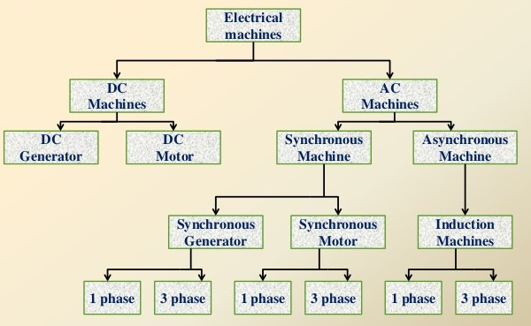

Slide 3
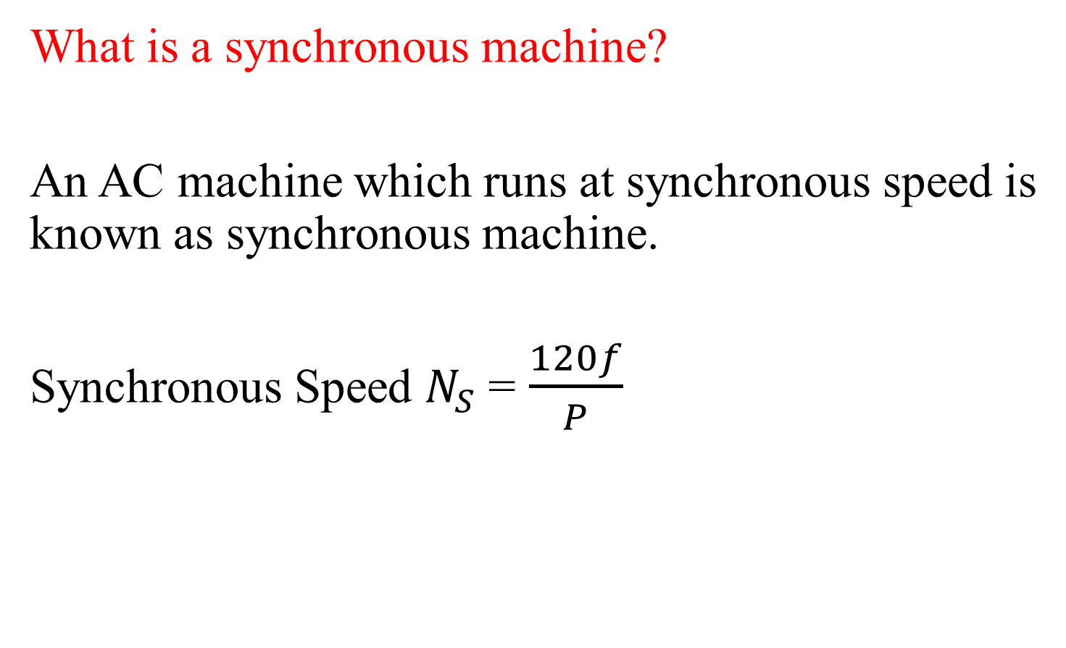
What is a synchronous machine?
An AC machine which runs at synchronous speed is known as synchronous machine.
Synchronous Speed $N_{S}$ = $\frac{120f}{P}$

Slide 4
MODULE 1
SYNCHRONOUS GENERATOR
“It is a synchronous machine which coverts mechanical power into AC electric power through the process of electromagnetic induction”

Slide 5
Synchronous Generator
Also called AC generator or alternator
Run at synchronous speed.
Operates on same principle of electromagnetic induction as dc generators
Consists of armature and magnetic field.
In dc generators, armature rotates and field is stationary.
Reverse in case of alternators.
Armature windings mounted on stator and field winding on rotor.

Slide 6
SYNCHRONOUS GENERATOR
Types of Synchronous Machine
According to the arrangement of the field and armature
windings, synchronous machines may be classified as
Stationary Armature - Rotating Field (Above 5 kVA)
(b) Stationary Field – Rotating Armature (Below 5 kVA)

Slide 7
Advantages of stationary armature - rotating field:
The High Voltage ac winding and its insulation not subjected to centrifugal forces (BETTER INSULATION)
Easier to collect large currents from stator.
Rotating field makes overall construction simple.
Problem of sparking at the slip ring can be avoided.
Ventilation arrangement for HV can be Improved.
The dc excitation easily supplied through slip rings and brushes to the rotor field winding.
Noiseless running is possible.
Air gap length is uniform
Better mechanical balancing of rotor

Slide 8
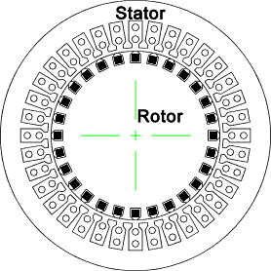
CONSTRUCTION OF ALTERNATOR
Stationary Armature - Rotating Field
An alternator has 3 phase winding on the stator and
DC field winding on the rotor.
STATOR
Stationary part of the machine.
It is built up of Sheet-Steel Lamination Core (Stampings) with slots
to hold the armature Conductor
Armature winding is connected in STAR

Slide 9
Stator Frame
Used to give mechanical support
Made up of cast iron or welded steel plates
For holding armature stampings and windings in position.
Stator Core
High permeability laminated silicon steel stampings.
Core is laminated to minimize loss due to eddy currents
Silicon steel- to reduced hysteresis loss
Slots are made in internal periphery of it.
Armature winding
Insulated Cu winding is placed in the slots of stator core.
Connected in star or in delta.

Slide 10
Why star connected armature preferred??
Star connection provides a neutral point so Neutral ground protection enabled
STAR connection eliminates the triplen harmonics in the generated terminal voltage of generator armature winding.
The insulation requirement in STAR connection is less. Since phase voltage is 1/√3 times of the line voltage

Slide 11
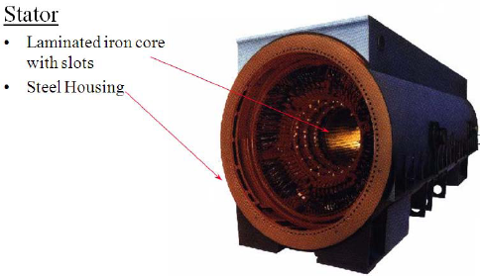

Slide 12
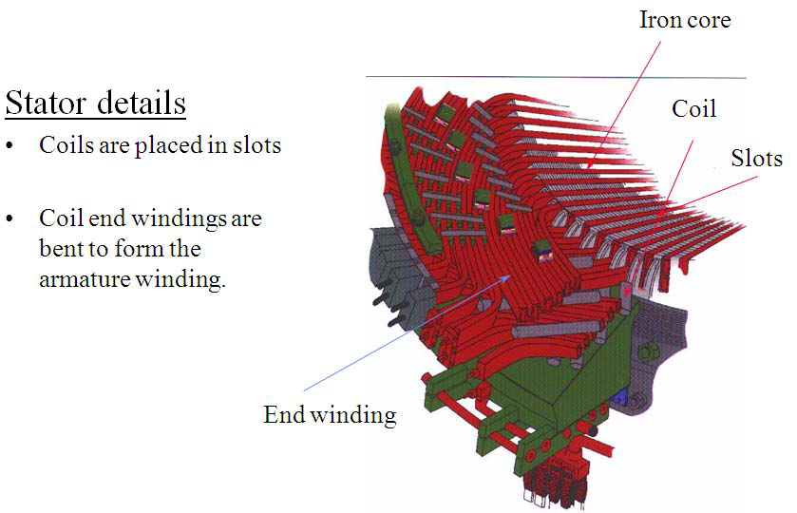

Slide 13
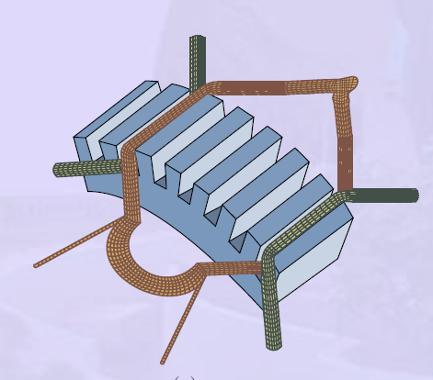
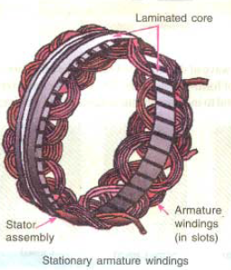

Slide 14
ROTOR:
There are two types of rotor
i) Salient Pole type {Projected Poles}
ii) Non - Salient Pole type {Non – Projected Poles} Smooth Cylindrical Type

Slide 15
Salient Pole type {Projected Poles}
It is also called Projected Poles.
Poles are mounted on the larger circular frame.
Made up of Thick Steel Laminations.
Field Winding are connected in series.
Ends of the field winding are connected to the DC Supply through Slip Rings
Features
Large Diameter and short Axial Length.
Poles are Laminated to reduced Eddy Current Losses
Employed for Low and Medium Speed
120 RMP to 500 RPM
(Diesel & Hydraulic Turbines)
This cannot be used for Large speed

Slide 16
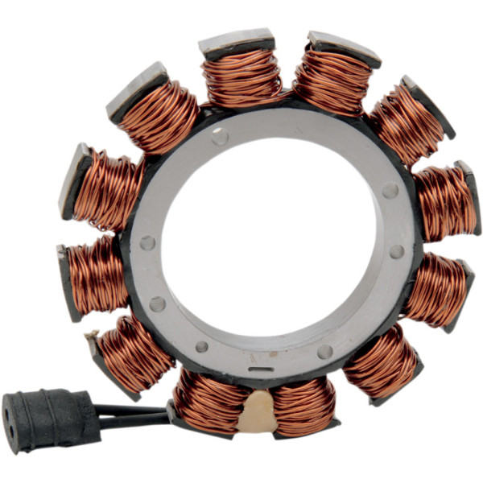
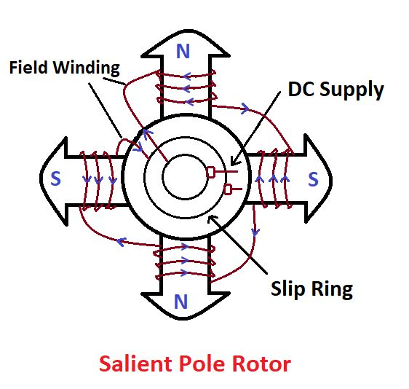

Slide 17
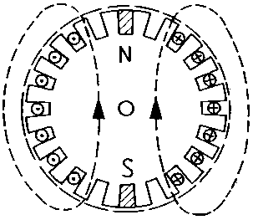
II) NON SALIENT POLE TYPE
Smooth cylindrical rotor or TURBO ALTERNATOR
field winding used in high speed alternators driven by steam turbines .
Features
Smaller diameter and larger axial length compared to salient pole type machines, of the same rating.
Less Windage loss.
Speed 1200 RPM to 3000 RPM.. Better Balancing..
Noiseless Operation
Flux distribution nearly sine wave
Frequency 50 Hz
Ns = 120 F / P
Poles | 2 | 4 | 6
Speed | 3000 | 1500 | 1000

Slide 18
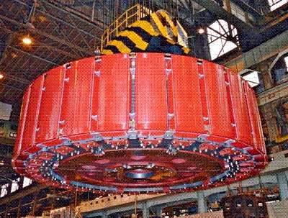

Slide 19
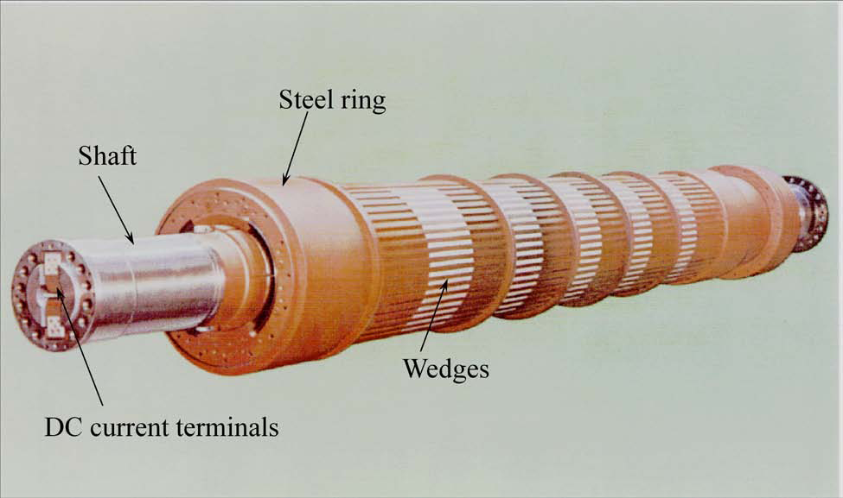

Slide 20
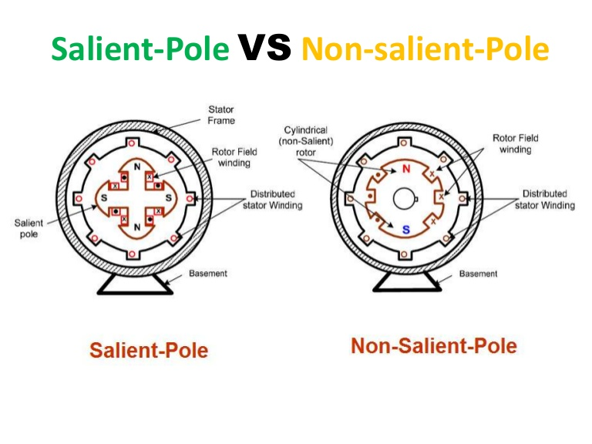

Slide 21
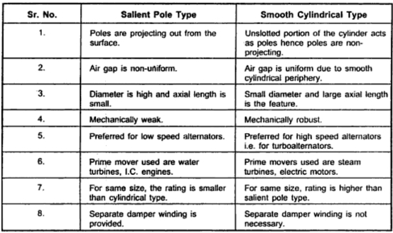

Slide 22
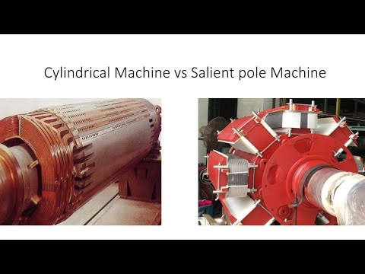

Slide 23
Working of alternator
Electromagnetic induction
when the flux linking a conductor changes, an EMF is induced in the conductor.
When the armature winding of alternator subjected to the rotating magnetic field, the voltage will be generated in the armature winding
When the rotor field winding of the alternator is energized from the DC exciter, the alternate N and S poles are developed on the rotor.

Slide 24
Now, this rotor is rotated in an anticlockwise direction with the help of a prime mover such as a turbine or engine, the armature conductors placed on the stator are cut by the magnetic field of the rotor poles.
As a result, the EMF is induced in the armature conductors due to electromagnetic induction. This induced EMF is alternating one because the N and S poles of the rotor pass the armature conductors alternatively.
The direction of the generated EMF can be determined by the Fleming’s right rule.

Slide 25
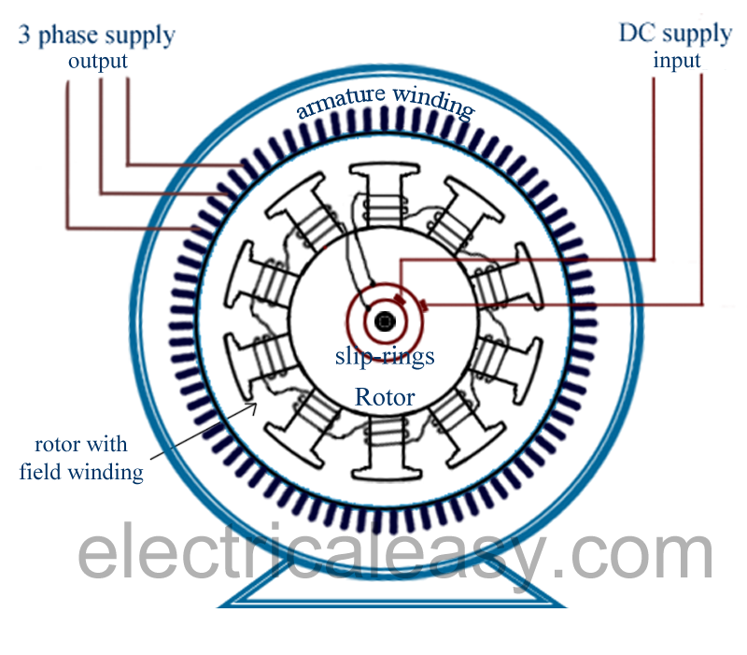

Slide 26

ARMATURE WINDING
3 Phase alternator carry 3 sets of winding arranged in slots
Open circuited
6 terminals
Can be connected in Star or Delta
Armature Winding Classification
Single Layer and Double Layer Winding
Full Pitch and Short Pitch Winding
Concentrated and Distributed Winding

Slide 27

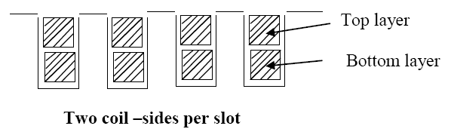
1. Single Layer and Double Layer Winding
Single- layer winding
• One coil-side occupies the total slot area
• Used only in small ac machines
Double- layer winding
• Coil-sides in two layers
• Double-layer winding is more common used above about 5kW machines
The advantages of double-layer winding over single layer winding:
a. Easier to manufacture and lower cost of the coils
b. Fractional-slot winding can be used
c. Chorded-winding is possible
d. Lower-leakage reactance and therefore , better performance of the machine
e. Better emf waveform in case of generators

Slide 28
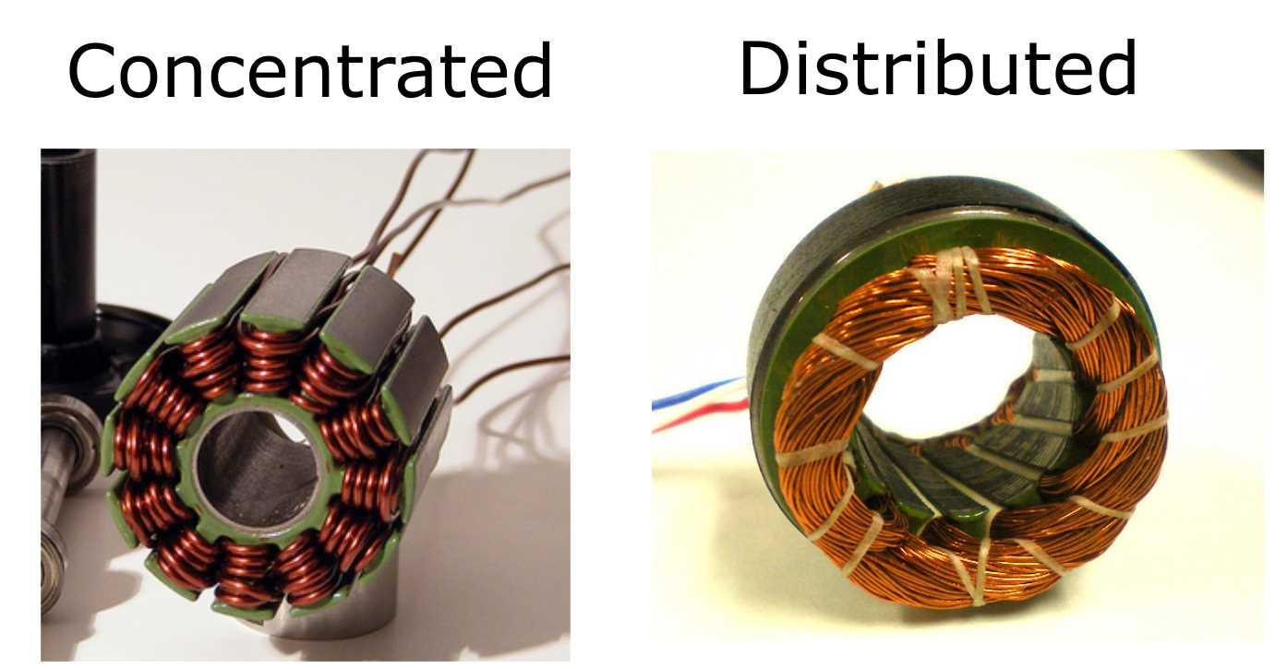
2.CONCENTRATED AND DISTRIBUTED WINDING

Slide 29
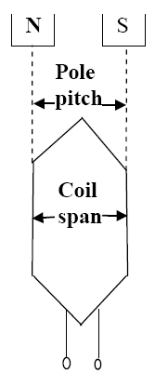
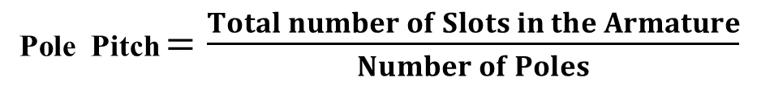
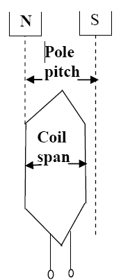
POLE – PITCH
It is the distance between the centres of pole
faces of two adjacent poles is called pole pitch.
Pole pitch = 180 Phase angle
COIL :
A coil consists of two coil sides.
Placed in two separate slots
SLOT PITCH:
It is the phase angle between two adjustment slots
COIL SPAN OR COIL PITCH
It is the distance between two coil sides of a coil

Slide 30
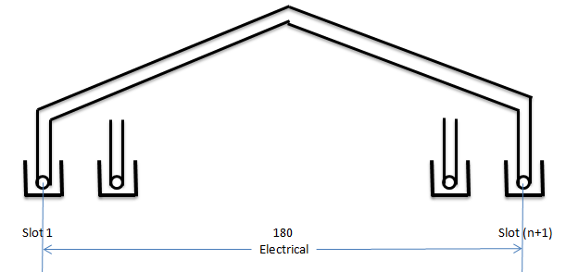
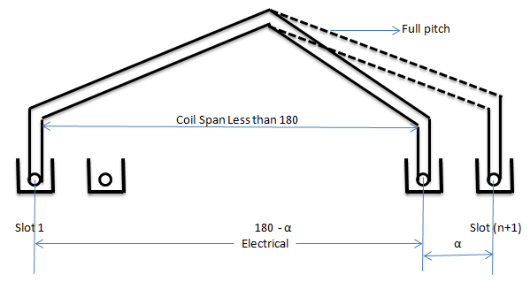
3.Full Pitch and Short Pitch Winding
Full Pitch Winding
If the coil span is equal to pole pitch then the winding is called Full Pitch Winding
Coil Span = Pole Pitch
e1 V
e2 V
Short Pitch Winding
If the coil span is less than Pole
Pitch is called Short pitch
winding
e2 V
e1 V
e2 V

Slide 31
Advantages of Short Chorded winding or Chorded Pitch Winding
Copper is saved
Mechanical strength of the coil is increased
Induced EMF in improved
Slot Angle : The angular displacement between any two
adjacent poles in electrical degree
Slot angle (β) = 180
(Number of slots / Pole)

